Slide 1
Canadian Healthcare Expenditure and Forecast From Canadian Institute for Health Information

Slide 2
Canadian Institute for Health Information Datasets

Slide 3
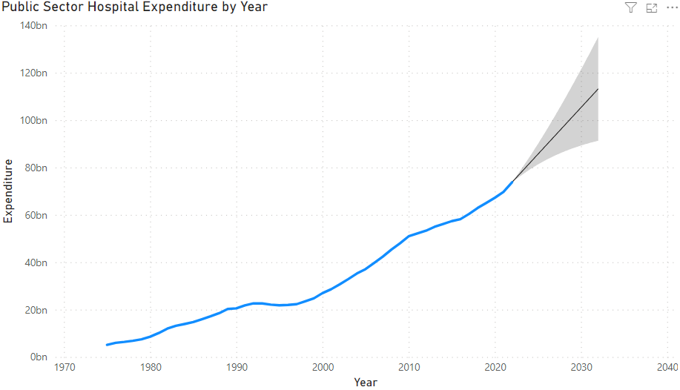
Health Expenditure Forecast by Year

Slide 4
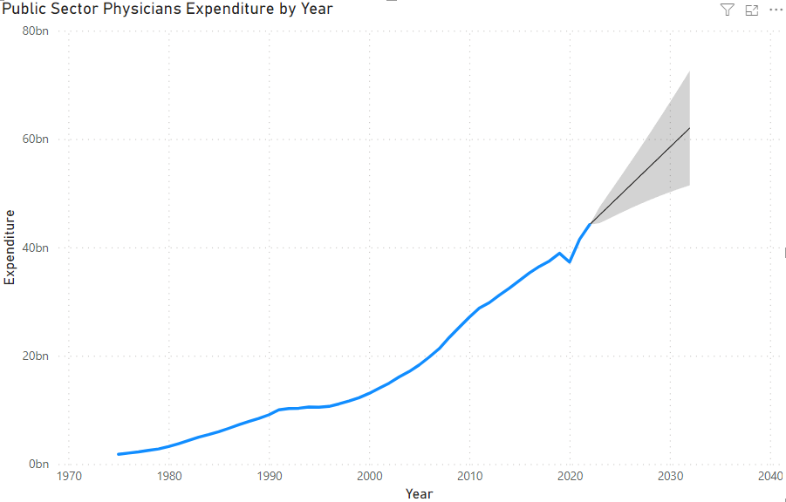
Health Expenditure Forecast by Year

Slide 5
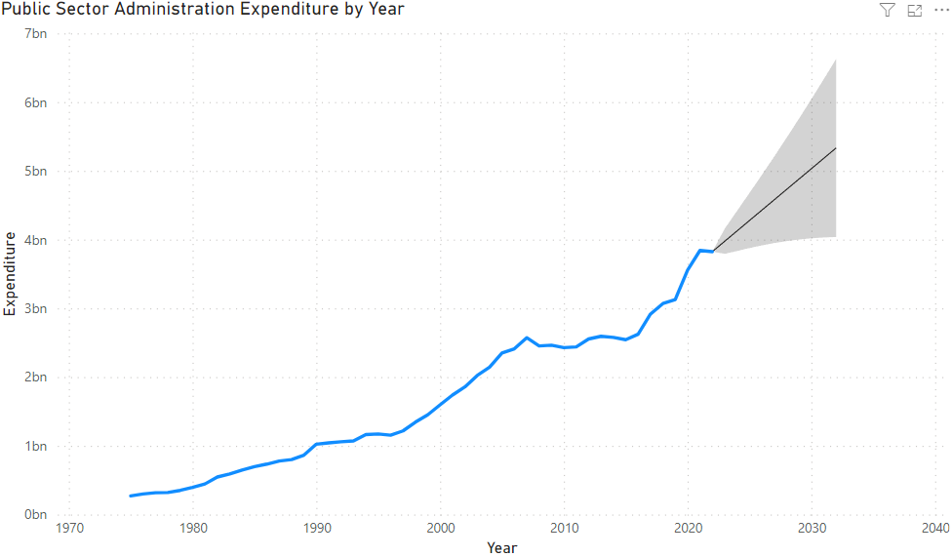
Health Expenditure Forecast by Year

Slide 6
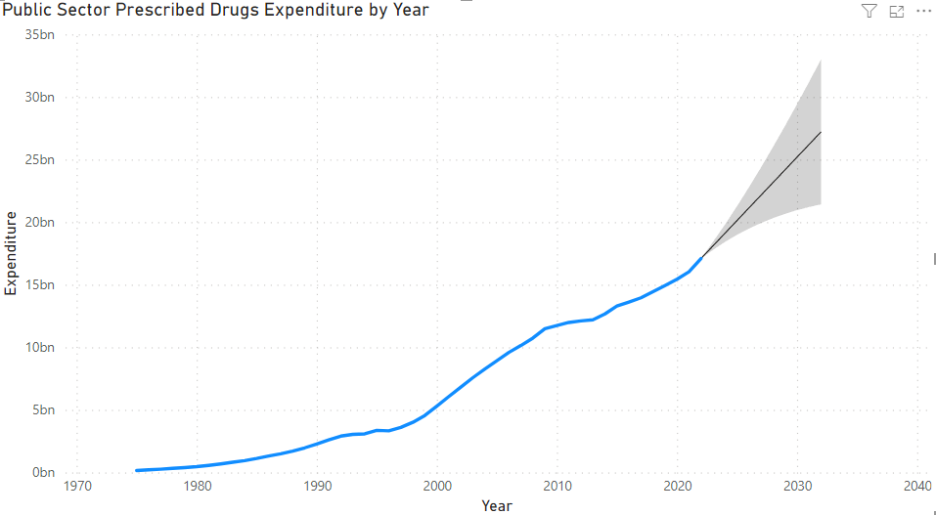
Health Expenditure Forecast by Year

Slide 7
Health Expenditure Forecast by Year
Year | Canadian Healthcare Expenditure | Average Canadian Healthcare Expenditure Per Person
2022 | $138 Billion | $4783.36 (Population of 38.85 million)
2032 Forecast | $213 Billion (54% Increase) | $4988.29 (Projected population of 43.7 million by Statistics Canada)

Slide 8
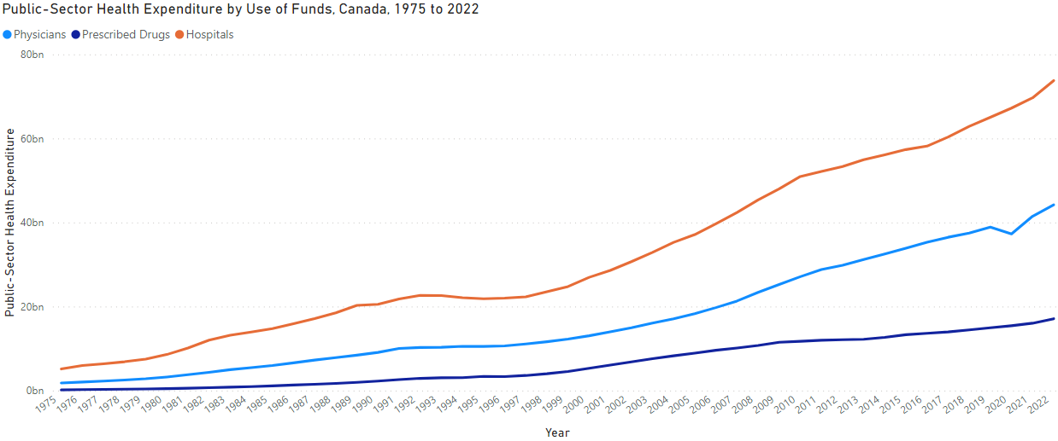
Health Expenditure by Year

Slide 9
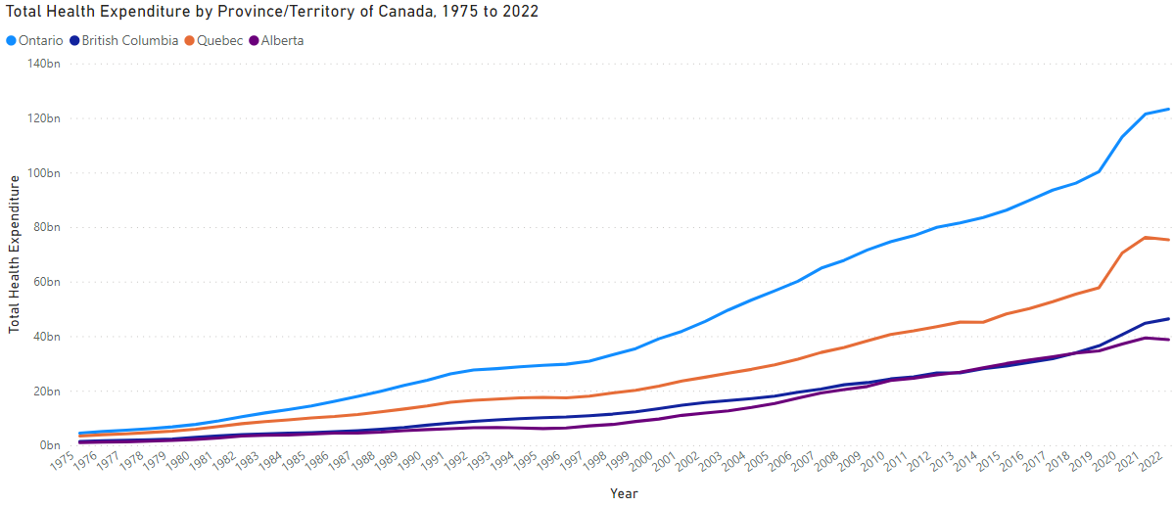
Health Expenditure by Year

Slide 10
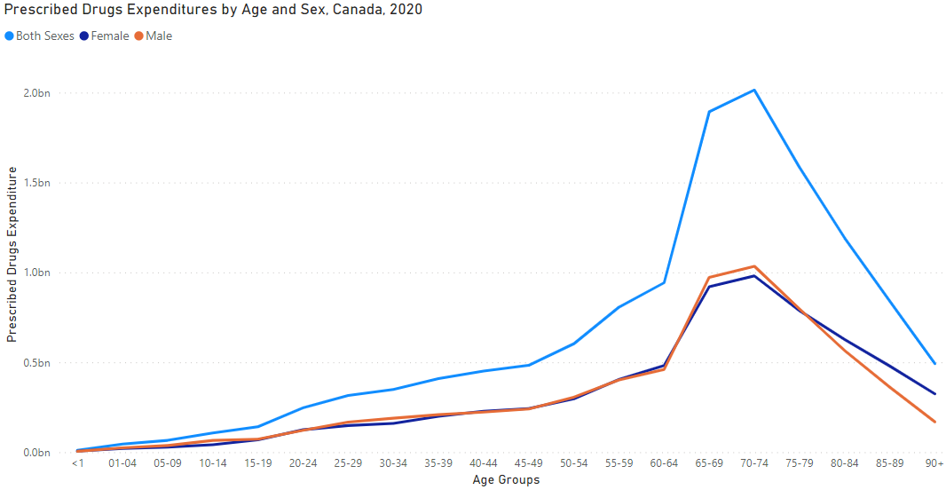
Health Expenditure by Year

